Slide 1


April 9, 26
ALPHA
PULSE
Portfolio Risk Simulation
Presented By : Group 1

Slide 2
Presented By : Group 1
OBJECTIVE
The objective of the AlphaPulse project is to analyze financial data and evaluate portfolio performance using key metrics such as alpha and returns. It focuses on cleaning and transforming raw datasets into accurate and reliable inputs for analysis. The project also aims to apply statistical and financial models to assess investment efficiency and risk. Finally, it seeks to present clear insights through an interactive dashboard, enabling better understanding and informed decision-making.

Slide 3
01
Data Acquisition
PROJECT PHASES
02
Quantitative Analysis
03
Risk Modeling
Our project is divided into
4 parts
04
Deployment

Slide 4
DATA ACQUISITION
The first phase of the AlphaPulse project focuses on collecting relevant and reliable financial data from various sources such as stock market APIs, financial websites, and publicly available datasets. This includes historical price data, market indices, and other key financial indicators required for analysis. Ensuring data accuracy, completeness, and consistency is a critical part of this phase. The acquired data serves as the foundation for all further processing, analysis, and visualization in the project.

Slide 5
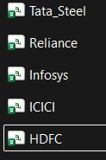
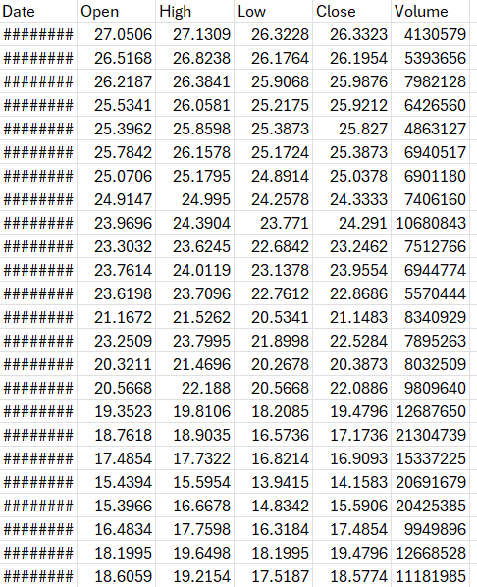
RAW DATASETS

Slide 6
QUANTITATIVE ANALYSIS
The quantitative analysis phase of the Alpha Pulse project focuses on applying statistical and mathematical techniques to evaluate portfolio performance. Key calculations include returns, alpha, and risk measures, which help in assessing how well an investment performs compared to the market.
Returns Calculation – Daily and overall returns to measure performance over time.
Alpha Calculation – Excess return of the portfolio compared to the market benchmark.
Beta Calculation – Sensitivity of the portfolio with respect to market movements.
Standard Deviation – Measures volatility or risk in the portfolio.
Variance – Shows the spread of returns from the mean.
Correlation – Identifies relationships between different stocks/assets.
Moving Averages – Helps in identifying trends in stock prices.
Risk-Return Analysis – Comparison of returns with associated risk.

Slide 7
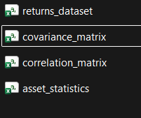
TRANSFORMED DATASETS

Slide 8
RISK MODELING
The risk modeling phase in the Alpha Pulse project focuses on identifying, measuring, and managing the uncertainty associated with investments. It involves analyzing the volatility of returns using measures like standard deviation and variance to understand how much the portfolio value can fluctuate
Standard Deviation – Measures how much the returns fluctuate (volatility).
Variance – Calculates the spread of returns from the average return.
Beta – Measures sensitivity of the portfolio compared to market movements.
Correlation Coefficient – Shows the relationship between different assets.
Value at Risk (VaR) – Estimates the maximum potential loss over a given time period at a certain confidence level.
Expected Return – Average return expected from the portfolio based on past data.
Sharpe Ratio – Measures risk-adjusted return (return per unit of risk).
Downside Risk – Focuses on negative returns or potential losses only.
These calculations help in understanding, quantifying, and managing investment risk effectively.

Slide 9
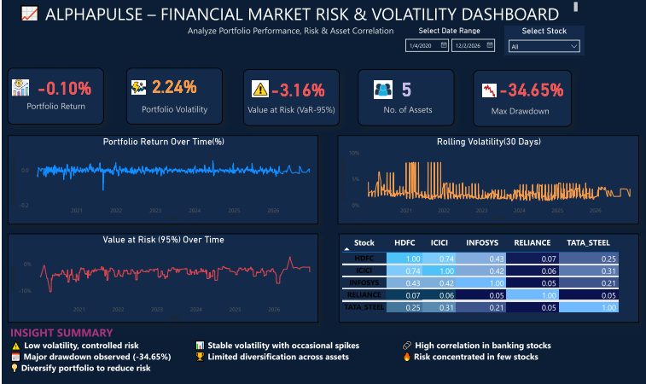
DASHBOARD

Slide 10
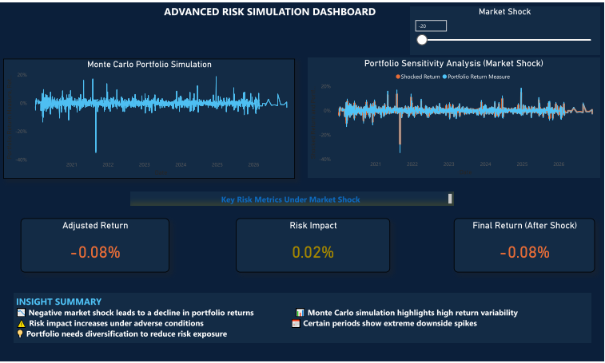
DASHBOARD

Slide 11
Group 1
THANK YOU

